Slide 1
Analyzing the Relationship Between Conflict and Water Scarcity
Team 2
Team Members
Chris Kellam
Matthew Smith
Jason Britton
Molly Fox

Slide 2
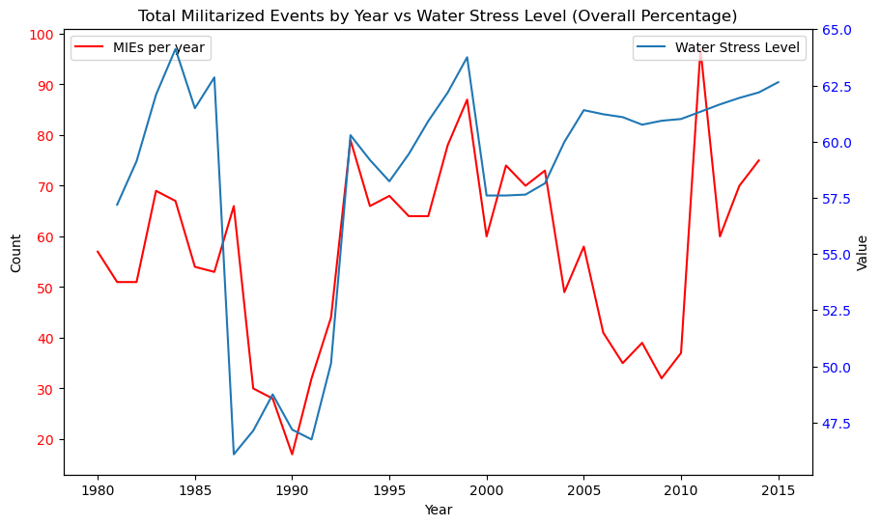
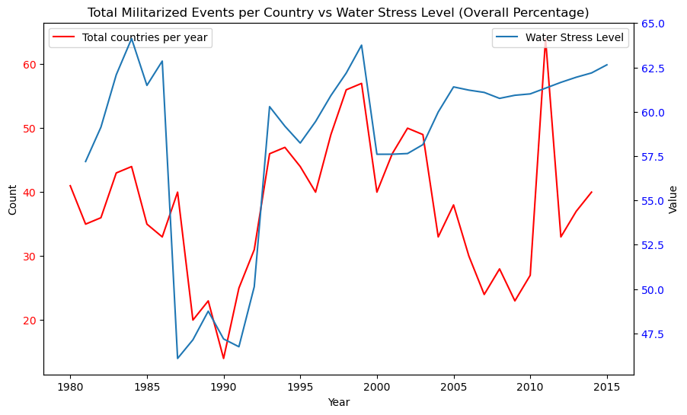
How does water scarcity correlate with the frequency and intensity of armed conflicts?

Slide 3
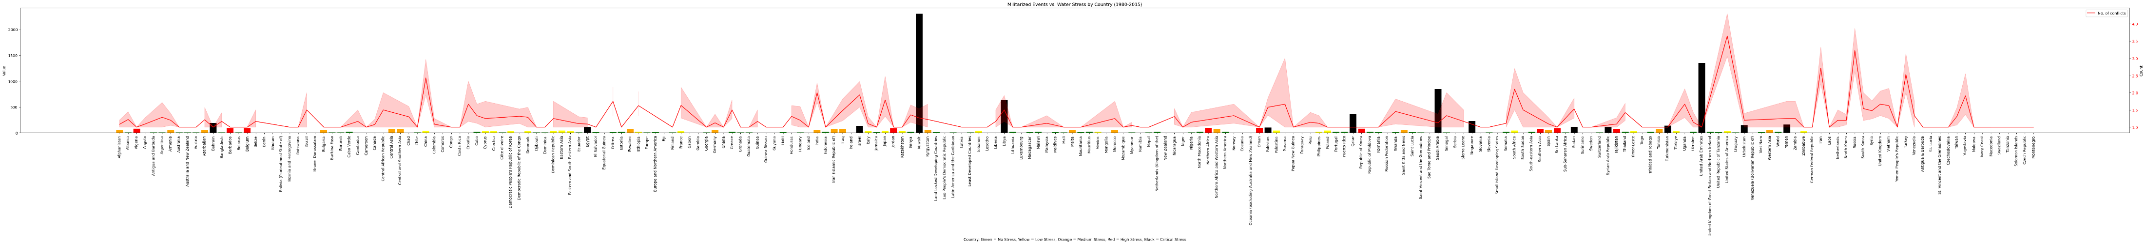
What are the geographical patterns of conflict relative to water scarcity?

Slide 4
Can changes in water availability predict increases in conflict events?

Slide 5
Are certain types of conflicts more likely to occur in water-scarce regions?

Slide 6
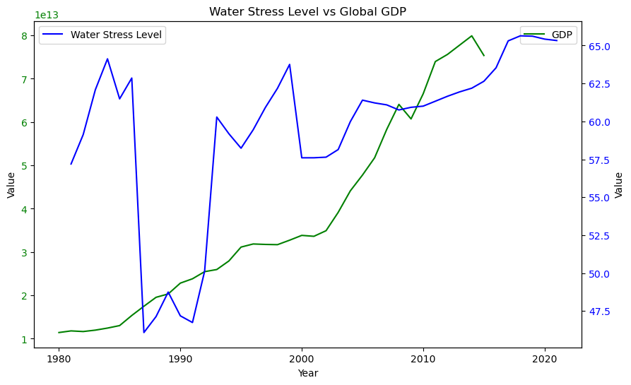
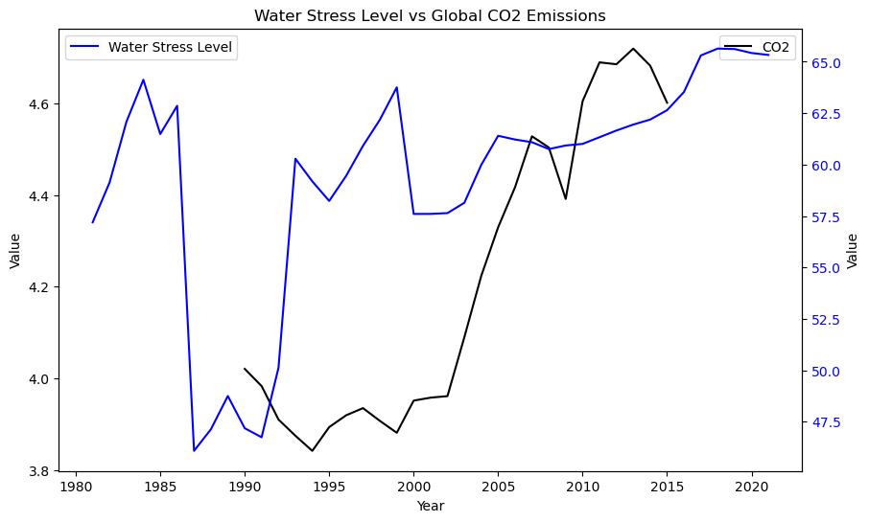
Are there other factors that affect the frequency of armed conflicts in water scarce areas?

Slide 7
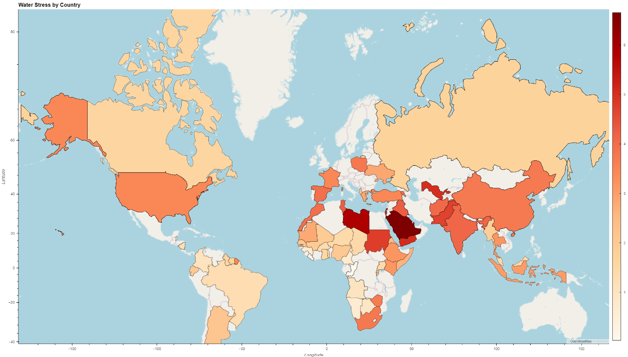

Slide 8
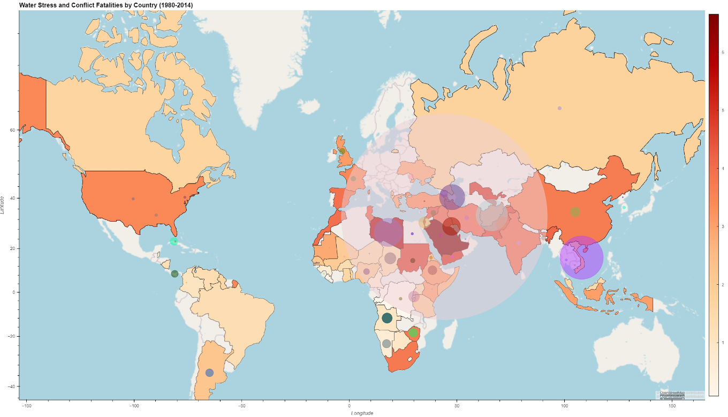

Slide 9
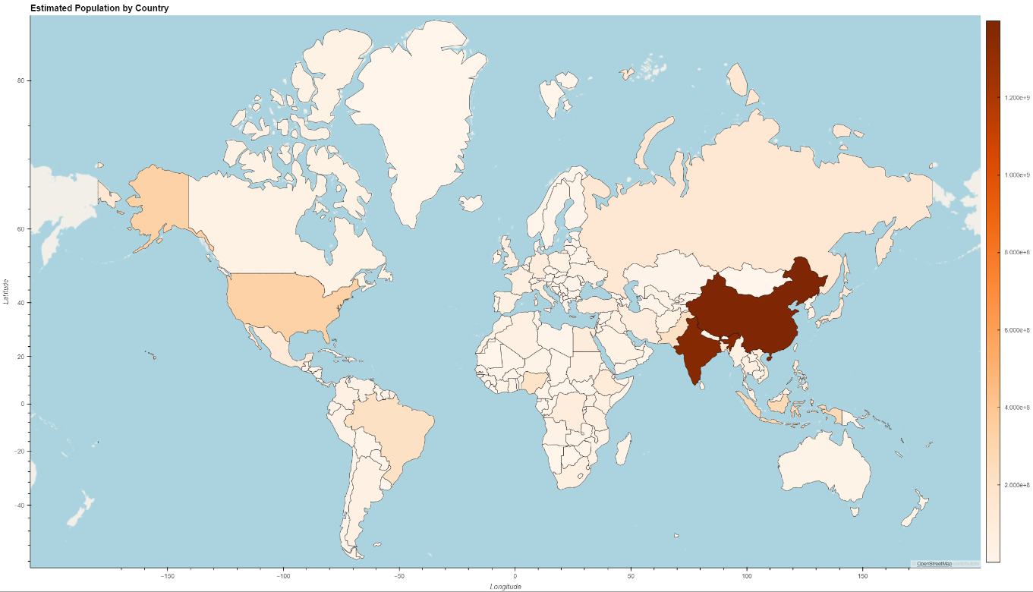

Slide 10
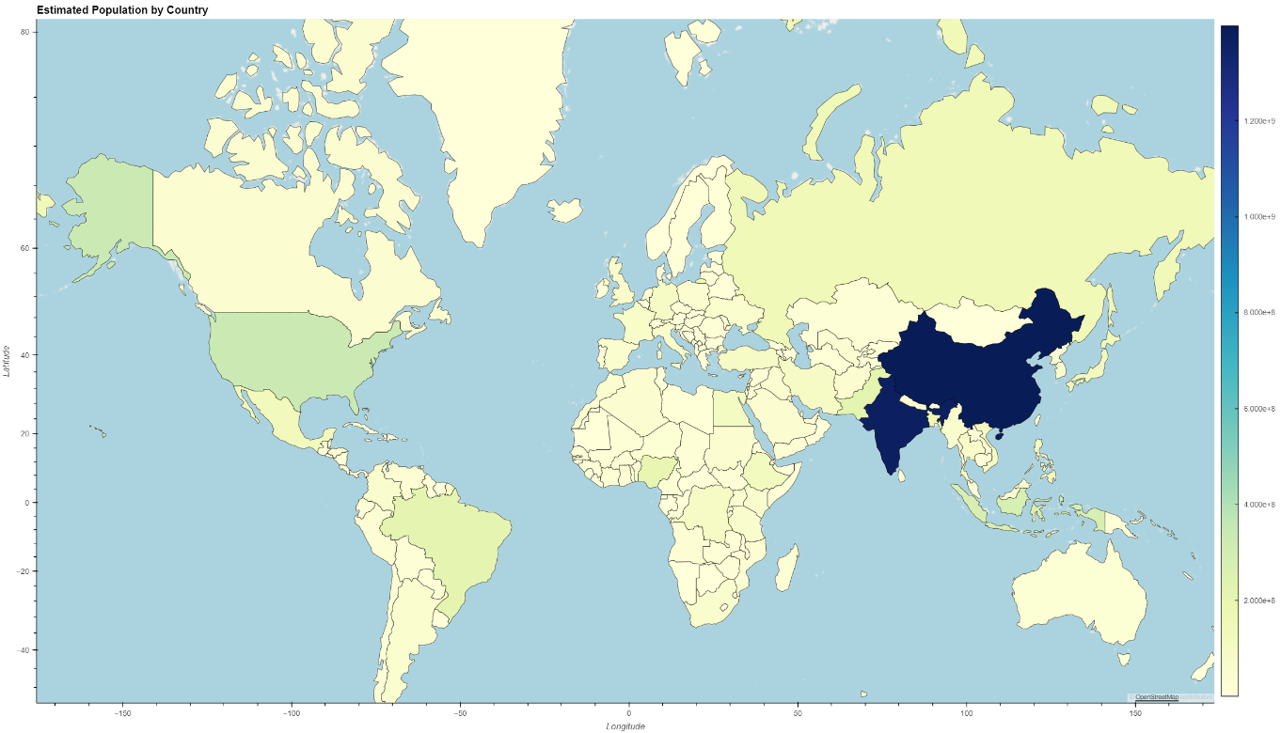

Slide 11
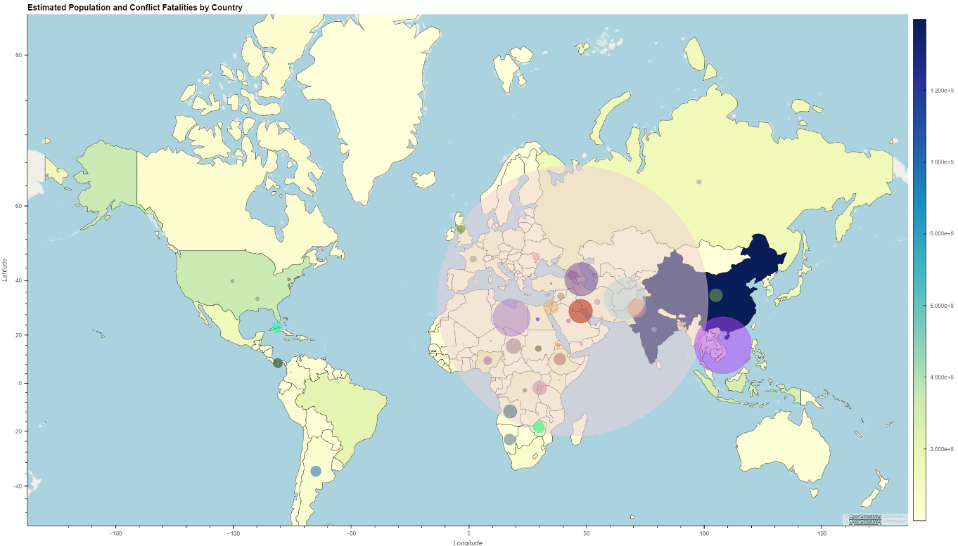

Slide 12
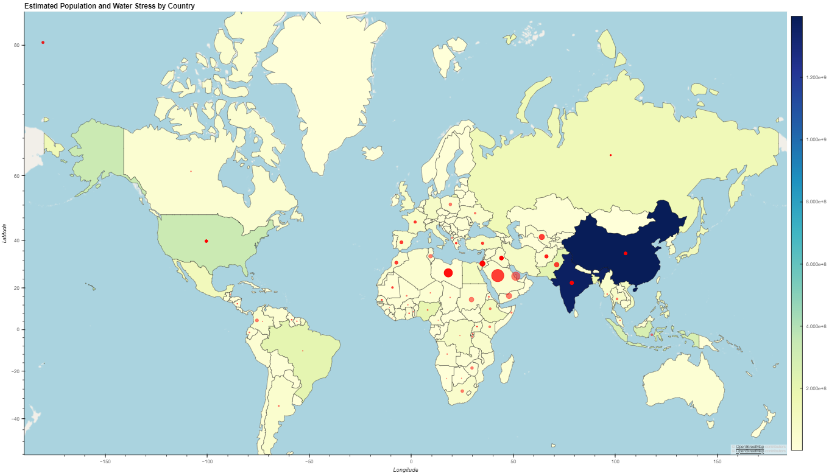

Slide 13
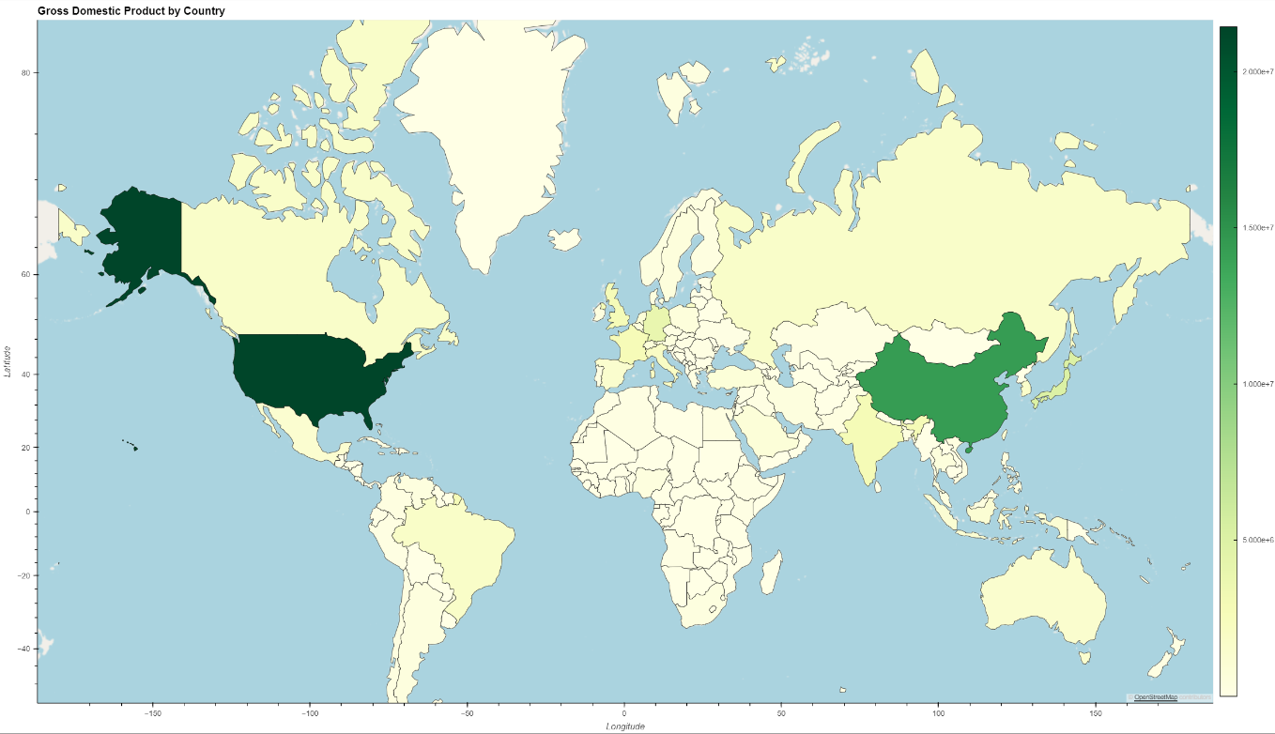

Slide 14
